Slide 1
OOAD

Slide 2
Design Process
OOA
OOD
User interface
Issues or GUI
prototype
Use case
diagram
Interaction
diagram
Informal
Requirements
SRS
document
Domain
model
Class
diagram
Code
Glossary

Slide 3
Domain Modelling
Represent objects appearing in the problem domain.
  Also capture object relationships.
Three types of objects are identified:
  Boundary objects
  Entity objects
  Controller objects

Slide 4
Boundary Objects
Handle interaction with actors:
  User interface objects
Often implemented as screens, menus, forms, dialogs etc.
Do not perform processing:
  But may validate input, format output, etc.

Slide 5
Entity Objects
Hold information over long term:
  e.g. Book, BookRegister, Member
Normally are dumb servers:
  Responsible for storing data, fetching data etc.
  Elementary operations on data such as searching, sorting, etc.
Often appear as nouns in the problem description...

Slide 6
Controller Objects
Help to realize use case behavior:
  Interface with the boundary objects
  Coordinate the activities of a set of entity objects
Embody most of the business logic:
  Take overall responsibility for use case execution.
Usually a use case is realized by one controller.

Slide 7
Controller Classes
Controller classes coordinate, sequence, transact, and otherwise control other objects…
In Smalltalk MVC mechanism:
  These are called controllers
Controller
Boundary
Entity

Slide 8
Example Use Case Realization
Boundary 1
Controller
Boundary 2
Entity 1
Entity 2
Entity 3
A use case is realized through the collaboration of
a controller and several boundary and entity objects

Slide 9
Identification of Boundary Objects
Need one boundary object :
  For every actor-use case pair
Tic-tac-toe game
Supermarket
Prize scheme
register
customer
Customer
Clerk
Play Move
register
sales
Sales Clerk
Player
select
winners
Manager

Slide 10
Identification of Controller Objects
Examine the use case diagram:
  Add one controller class for each use case.
  Later on, some controllers may need to be split into two or more controller classes if they have too much responsibility.
Supermarket
Prize scheme
Tic-tac-toe game
register
customer
Customer
Clerk
Play Move
register
sales
Sales Clerk
select
winners
Player
Manager

Slide 11
Identification of Entity Objects
Usually appear as common nouns in the problem description.
From the list of nouns, need to exclude:
  Users (e.g. accountant, librarian, etc)
  Passive verbs (e.g. Acknowledgment)
  Those with which you can not associate any methods
  Those with which you can not associate any data to store
Surrogate users may exist as classes:
  Library member

Slide 12
Identify Classes
A partial requirements document:
Of course, not all nouns will correspond to a class or object in the final solution
The user must be allowed to specify each product by
its primary characteristics, including its name and
product number. If the bar code does not match the
product, then an error should be generated to the
message window and entered into the error log. The
summary report of all transactions must be structured
as specified in section 7.A.

Slide 13
Identify Entity Classes
Eliminate improbable nouns:
The user must be allowed to specify each product by
its primary characteristics, including its name and
product number. If the bar code does not match the
product, then an error should be generated to the
message window and entered into the error log. The
summary report of all transactions must be structured
as specified in section 7.A.

Slide 14
Noun Analysis: Another Example
A trading house maintains names and addresses of its regular customers. Each customer is assigned a unique customer identification number (CIN). As per current practice, when a customer places order, the accounts department first checks the credit-worthiness of the customer.

Slide 15
Identifying Classes by Noun Analysis
A partial requirements document:
Not all nouns correspond to a class in the domain model
A trading house maintains names and addresses of its regular customers. Each customer is assigned a unique customer identification number (CIN). As per current practice, when a customer places order, The accounts department first checks the credit-worthiness of the customer.

Slide 16
It is Challenging to Identify Classes!
Often it is challenging to decide:
  Whether something should be represented as a class
Example:
  Should an employee's address be represented as a set of instance variables or as an Address object
When a class becomes too complex,:
  It should be decomposed into multiple smaller classes to distribute the responsibilities

Slide 17
Identification of Entity Objects: Some Hints
Usually:
  Appear as data stores in DFD
  Occur as aggregate objects
  The aggregator corresponds to registers in physical world
CustomerRegister
*
CustomerRecord

Slide 18
Naming Classes
Class names should be singular nouns
  Examples: Coin, Student, Message

Slide 19
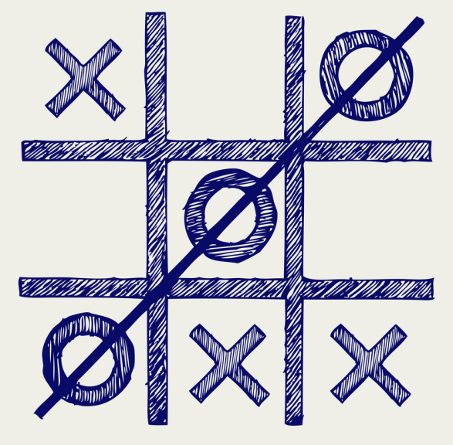
Example 1: Tic-Tac-Toe Computer Game
A human player and the computer make alternate moves on a 3X3 square.
A move consists of marking a previously unmarked square.
The user inputs a number between 1 and 9 to mark a square
Whoever is first to place three consecutive marks along a straight line (i.e., along a row, column, or diagonal) on the square wins.

Slide 20
Example 1: Tic-Tac-Toe Computer Game cont…
As soon as either of the human player or the computer wins,
  A message announcing the winner should be displayed.
If neither player manages to get three consecutive marks along a straight line,
  And all the squares on the board are filled up,
  Then the game is drawn.
The computer always tries to win a game.

Slide 21
Example 1: Tic-Tac-Toe
Use Case Model
Tic-tac-toe game
Play Move
Player

Slide 22
Example 1: Initial and Refined Domain Model
Board
Initial domain model
PlayMoveBoundary
PlayMoveController
Board
Refined domain model

Slide 23
Example 1: Sequence Diagram
:playMove
Boundary
:playMove
Controller
:board
acceptMove
checkMoveValidity
move
[invalidMove]
[invalidMove]
announceInvalidMove
announceInvalidMove
checkWinner
[game over]
[game over]
announceResult
announceResult
playMove
checkWinner
[game over]
[game over]
announceResult
announceResult
displayBoardPositions
getBoardPositions
[game not over]
promptNextMove
Sequence Diagram for the play move use case

Slide 24
Example 1: Class Diagram
Board
PlayMoveBoundary
int position[9]
checkMove Validity
checkResult
playMove
announceInvalidMove
announceResult
displayBoard
Controller
announceInvalidMove
announceResult

